Slide 2
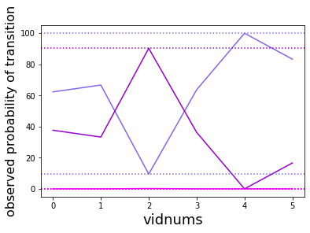
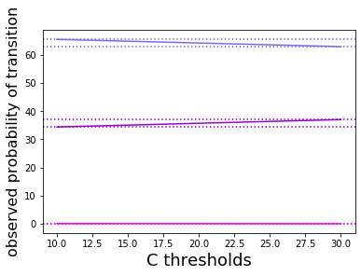
Study Question
The probability of going to plastic and both states when new videos come
Notice it flipflops eevery time, so it’s like a tossu, but clearly the videos with plastic preferred are the longer ones with more transitions. It’s possible once a run of transitions starts the state to be preferred is already chosen by the initial conditions, and the plastic runs were longer, maybe because it’s easier to do / conserves more enrgy in the doing for subsequent sips/whatever it is makes skips lnger on some conditions than other – which is one way to be a ‘preferred’ state.
And now that every video is condensed (for ehc set of thresholds), plastic was clearly preferred
There’s still some chance it could be error in counting, of the kind that used to blow up the diagonals, but it’s the same algorithm as before.

Slide 3
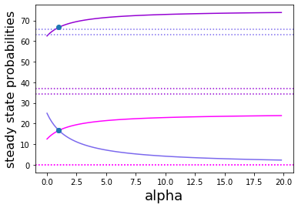
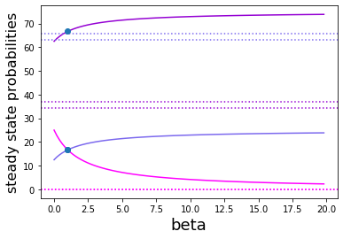
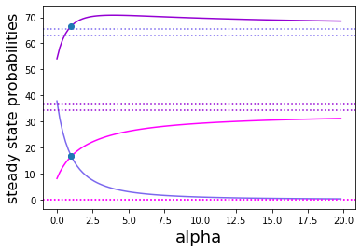
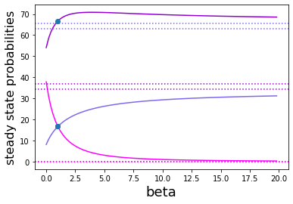
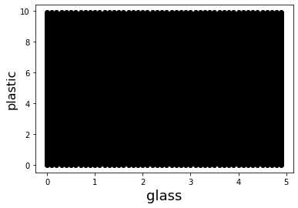
Hinging is not doing any favours to the data
And neither is breaking apart
Which is why the plot for fitting the two bonding strengths to the data comes up empty

